Slide 1
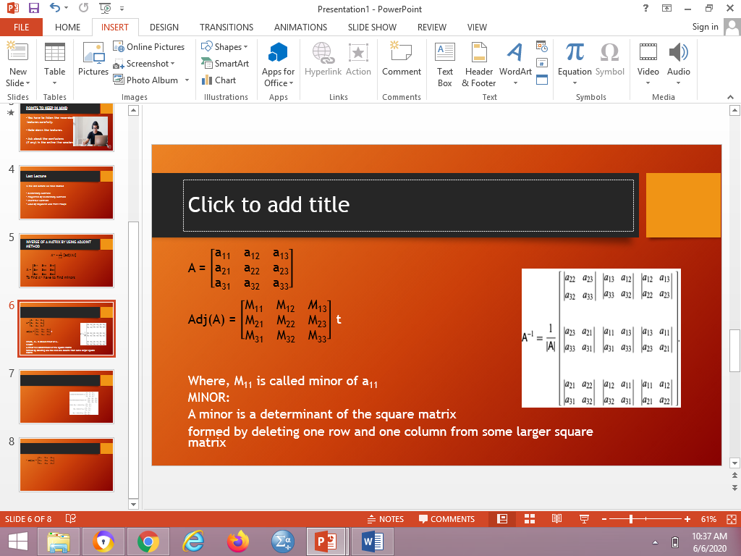

INVERSE OF A MATRIX BY USING ADJOINT METHOD
A⁻¹ = $\frac{1}{\left|A\right|}$ [adj(A)]
A = $\left[\begin{aligned}\text{a}\text{11} \text{a}\text{12 }\text{a}\text{13} \\ \text{a}\text{21} \text{a}\text{22} \text{a}\text{23} \\ \text{a}\text{31} \text{a}\text{32} \text{a}\text{33}\end{aligned}\right]$
Adj(A) = $\left[\begin{aligned}\text{M}\text{11 }\text{M}\text{12 }\text{M}\text{13} \\ \text{M}\text{21 }\text{M}\text{22 }\text{M}\text{23} \\ \text{M}\text{31 }\text{M}\text{32 }\text{M}\text{33}\end{aligned}\right]$
Where $\text{M}\text{11}$ is called minor

Slide 2


Cont.
MINOR:A minor is a determinant of the square matrix formed by deleting one row and one column from some larger square matrix.
Adj(A) = $\left[\begin{aligned}\text{M}\text{11 }\text{M}\text{12 }\text{M}\text{13} \\ \text{M}\text{21 }\text{M}\text{22 }\text{M}\text{23} \\ \text{M}\text{31 }\text{M}\text{32 }\text{M}\text{33}\end{aligned}\right]$
Where, $\text{M}\text{11}$ is called minor of $\text{a}\text{11}$
A = $\left[\begin{aligned}\text{a}\text{11 }\text{a}\text{12 }\text{a}\text{13} \\ \text{a}\text{21 }\text{a}\text{22 }\text{a}\text{23} \\ \text{a}\text{31 }\text{a}\text{32 }\text{a}\text{33}\end{aligned}\right]$
$\text{M}\text{11}$ = (-1)¹⁺¹$×\left|\begin{aligned}\text{a}\text{22 }\text{a}\text{23} \\ \text{a}\text{32 }\text{a}\text{33}\end{aligned}\right|$
$\text{M}\text{12}$ = (-1)¹⁺²$×\left|\begin{aligned}\text{a}\text{2}\text{1} \text{a}\text{23} \\ \text{a}\text{3}\text{1} \text{a}\text{33}\end{aligned}\right|$
$\text{M}\text{1}\text{3}$ = (-1)¹⁺³$×\left|\begin{aligned}\text{a}\text{2}\text{1} \text{a}\text{2}\text{2} \\ \text{a}\text{3}\text{1} \text{a}\text{3}\text{2}\end{aligned}\right|$
.
.
.
$\text{M}\text{3}\text{3}$ = (-1)³⁺³$×\left|\begin{aligned}\text{a}\text{1}\text{1 }\text{a}\text{1}\text{2} \\ \text{a}\text{2}\text{1 }\text{a}\text{2}\text{2}\end{aligned}\right|$

Slide 3


EXAMPLE:
Q) Find the inverse of the given
Matrix.
A = $\left[\begin{aligned}\text{9} \text{2} \text{1} \\ \text{5} \text{−1} \text{6} \\ \text{4} \text{0} \text{−2}\end{aligned}\right]$
SOLUTION:
$\left|\text{A}\right|$ = $\left|\begin{aligned}\text{9} \text{2} \text{1} \\ \text{5} \text{−1} \text{6} \\ \text{4} \text{0} \text{−2}\end{aligned}\right|$
$\left|\text{A}\right|$ = 9(2-0) – 2(-10–24) + 1(0+4)
$\left|\text{A}\right|$ = 90 so matrix A is invertible
A⁻¹ = $\frac{1}{\left|A\right|}$ [adj(A)]

Slide 4



Cont.
$\text{M}\text{11}$ = (-1)¹⁺¹$×\left|\begin{aligned}\text{a}\text{22 }\text{a}\text{23} \\ \text{a}\text{32 }\text{a}\text{33}\end{aligned}\right|$
$\text{M}\text{12}$ = (-1)¹⁺²$×\left|\begin{aligned}\text{a}\text{2}\text{1} \text{a}\text{23} \\ \text{a}\text{3}\text{1} \text{a}\text{33}\end{aligned}\right|$
$\text{M}\text{1}\text{3}$ = (-1)¹⁺³$×\left|\begin{aligned}\text{a}\text{2}\text{1} \text{a}\text{2}\text{2} \\ \text{a}\text{3}\text{1} \text{a}\text{3}\text{2}\end{aligned}\right|$
.
.
.
$\text{M}\text{3}\text{3}$ = (-1)³⁺³$×\left|\begin{aligned}\text{a}\text{1}\text{1 }\text{a}\text{1}\text{2} \\ \text{a}\text{2}\text{1 }\text{a}\text{2}\text{2}\end{aligned}\right|$
To find Adj(A) we have calculate minors,
$\text{M}\text{11}$ = (-1)¹⁺¹$×\left|\begin{aligned}\text{−1} \text{6} \\ \text{0} \text{−2}\end{aligned}\right|$ = 1*[(-1*-2)-(0*6)]= 2
$\text{M}\text{12}$ = (-1)¹⁺²$×\left|\begin{aligned}\text{5} \text{6} \\ \text{4} \text{−2}\end{aligned}\right|$ = -1*[(5*-2) – (6*4)]= 34
$\text{M}\text{13}$ = (-1)¹⁺³$×\left|\begin{aligned}\text{5} \text{−1} \\ \text{4} \text{0}\end{aligned}\right|$ = 1*[(5*0)-(-1*4)] = 4
$\text{M}\text{21}$ = (-1)²⁺¹$×\left|\begin{aligned}\text{2} \text{1} \\ \text{0} \text{−2}\end{aligned}\right|$ = -1*(-4 – 0) = 4
$\text{M}\text{2}\text{2}$ = (-1)²⁺²$×\left|\begin{aligned}\text{9} \text{1} \\ \text{4} \text{−2}\end{aligned}\right|$ = 1*(-18 - 4) = -22
A = $\left[\begin{aligned}\text{9} \text{2} \text{1} \\ \text{5} \text{−1} \text{6} \\ \text{4} \text{0} \text{−2}\end{aligned}\right]$

Slide 5


Cont.
$\text{M}\text{2}\text{3}$ = (-1)²⁺³$×\left|\begin{aligned}\text{9} \text{2} \\ \text{4} \text{0}\end{aligned}\right|$ = -1*(0 - 8) = 8
$\text{M}\text{31}$ = (-1)³⁺¹$×\left|\begin{aligned}\text{2} \text{1} \\ \text{−1} \text{6}\end{aligned}\right|$ = 1*[12 – (-1)] = 13
$\text{M}\text{3}\text{2}$ = (-1)³⁺²$×\left|\begin{aligned}\text{9} \text{1} \\ \text{5} \text{6}\end{aligned}\right|$ = -1*(54 – 5) = -49
$\text{M}\text{3}\text{3}$ = (-1)³⁺³$×\left|\begin{aligned}\text{9} \text{2} \\ \text{5} \text{−1}\end{aligned}\right|$ = 1*(-9 – 10) = -19
A = $\left[ \begin{aligned}\text{9} \text{2} \text{1} \\ \text{5} \text{−1} \text{6} \\ \text{4} \text{0} \text{−2}\end{aligned} \right]$

Slide 6

Cont.
We know that,
Adj(A) = $\left[\begin{aligned}\text{M}\text{11 }\text{M}\text{12 }\text{M}\text{13} \\ \text{M}\text{21 }\text{M}\text{22 }\text{M}\text{23} \\ \text{M}\text{31 }\text{M}\text{32 }\text{M}\text{33}\end{aligned}\right]$
Adj(A) = $\left[\begin{aligned}\text{2} \text{34} \text{4} \\ \text{4} \text{−22} \text{8} \\ \text{13} \text{−49} \text{−19}\end{aligned}\right]$
Adj(A) = $\left[\begin{aligned}\text{2} \text{4} \text{13} \\ \text{3}\text{4} \text{−22} \text{−49} \\ \text{4} \text{8} \text{−19}\end{aligned}\right]$

Slide 7


Cont.
A⁻¹ = $\frac{1}{\left|A\right|}$ [adj(A)]
Adj(A) = $\left[\begin{aligned}\text{2} \text{4} \text{13} \\ \text{34} \text{−22} \text{−49} \\ \text{4} \text{8} \text{−19}\end{aligned}\right]$
And $\left|\text{A}\right|$ = 90
A⁻¹ = $\frac{1}{90}$ $\left[\begin{aligned}\text{2} \text{4} \text{13} \\ \text{34} \text{−22} \text{−49} \\ \text{4} \text{8} \text{−19}\end{aligned}\right]$
A⁻¹ = $\left[\begin{aligned}\text{2/}\text{90} \text{4/}\text{90} \text{13/90} \\ \text{34/90} \text{−}\text{22/90} \text{−49/90} \\ \text{4/90} \text{8/90} \text{−19/90}\end{aligned}\right]$
A⁻¹ = $\left[\begin{aligned}\text{1/45} \text{2/45} \text{13/90} \\ \text{17/45} \text{−11/45} \text{−4}\text{9/90} \\ \text{2/45} \text{4/45} \text{−19/90}\end{aligned}\right]$

Slide 8

PROPERTY
According to property A$×$ A⁻¹ = I₃
A = $\left[ \begin{aligned}\text{9} \text{2} \text{1} \\ \text{5} \text{−1} \text{6} \\ \text{4} \text{0} \text{−2}\end{aligned} \right]$ & A⁻¹ = $\left[\begin{aligned}\text{1/45} \text{2/45} \text{13/90} \\ \text{17/45} \text{−11/45} \text{−49/90} \\ \text{2/45} \text{4/45} \text{−19/90}\end{aligned}\right]$
A$×$ A⁻¹ = $\left[ \begin{aligned}\text{9} \text{2} \text{1} \\ \text{5} \text{−1} \text{6} \\ \text{4} \text{0} \text{−2}\end{aligned} \right]$ $×$ $\left[\begin{aligned}\text{1/45} \text{2/45} \text{13/90} \\ \text{17/45} \text{−11/45} \text{−49/90} \\ \text{2/45} \text{4/45} \text{−19/90}\end{aligned}\right]$
A$×$ A⁻¹ = $\left[ \begin{aligned}\text{1} \text{0} \text{0} \\ \text{0} \text{1} \text{0} \\ \text{0} \text{0} \text{1}\end{aligned} \right]$ Which ia an identity matrix of order 3 $×$3.

